Slide 1
Welcome to UOC

Slide 2
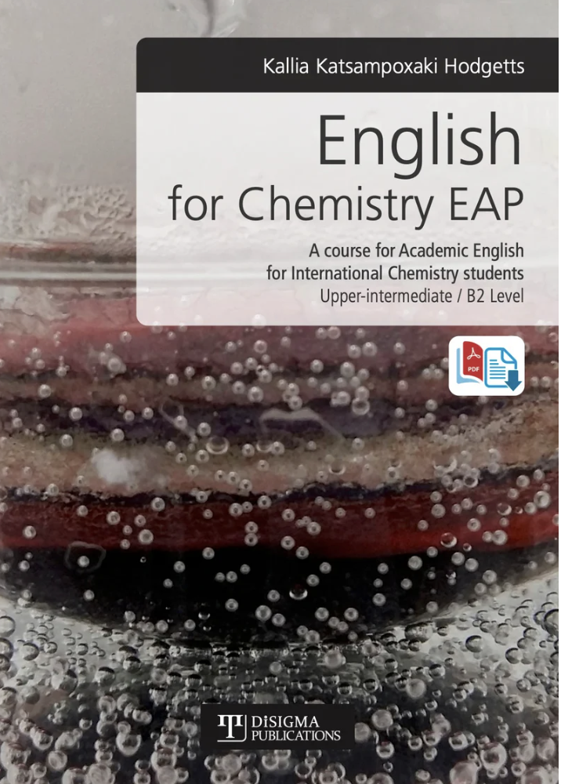
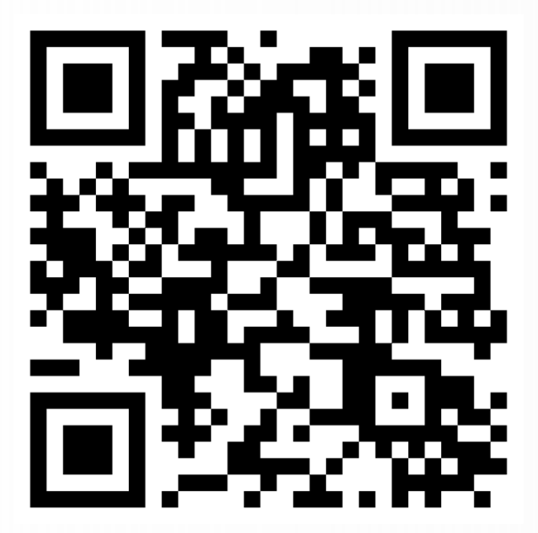
Academic
English 1
Lesson 1
Kallia Katsampoxaki-Hodgetts
University of Crete

Slide 3
Syllabus
Weekly programme
Induction week
Properties and state of matter
Energy types
Chemical elements
Periodic table and atomic structure
Nitrogen cycle
Chemical reactions
Laboratory safety issues
Chemical bonding
Intermolecular forces
From Electricity to Electrochemistry
Mock Exam_Team Based Learning
More on https://www.chemistry.uoc.gr/eclass/courses/CHEM-UNDER161/

Slide 4
Proficiency holders
You are not exempted from this course
Scientific terminology
Minimum expected level in this class is B2

Slide 5
Υποστηρικτικά μαθήματα
If you don’t speak English or your level is lower than B1, write your name, number and email in the paper provided.
Εαν το επίπεδό σας στα Αγγλικά είναι χαμηλό, συμπληρώστε τα στοιχεία σας στην φόρμα για να σας προσφερθεί εναλλακτική στήριξη και τρόπος εξέτασης.

Slide 6
Assessment modes
TYPE A
Weekly samples of classwork 20%
Written exams (80%): a. Reading comprehension (unknown reading text), b. Define known scientific words in English, c. Listen to a lecture, take notes and write a summary, d.Write an essay or report on a topic discussed in class.
TYPE B
100% Final Exams

Slide 7
Submit your samples of work after the lesson here
https://www.chemistry.uoc.gr/eclass/courses/CHEM-UNDER161/

Slide 8
Step 1: Name tags
Fold your paper in half. On half of one side of your paper, write your full name and nickname and student number in brackets (underneath).
On the other half, write down any three words that you associate as part of your identity as an undergraduate chemistry student. They can be nouns, adjectives, or verbs.
I will collect your name tag at the end of the lesson.

Slide 9
Can you follow instructions carefully?
Can you brainstorm?
Can you summarise your thoughts concisely?

Slide 10
Step 2 Read this carefully and ask me any questions
Identity entails an ever-present interest which is often difficult to concretise. Similar to other young people, undergraduate chemistry students do not often identify themselves as “scientists” and they do not necessarily subscribe to “hard sciences”. Being a university instructor, I find working with young researchers very rewarding and noticing my students’ transition from passive recipients of information to critical thinking autonomous learners is the ultimate goal of my teaching practice. Recently though I discovered I also like hiking. In this light, it wouldn’t be far fetched to say that although my preferences in my personal life appear to define one’s identity, these tendencies or trends are likely to remain constant within the next five years but a change is still probable (Kroger et al, 2010).
References
Kroger J., Martinussen M. and Marcia J. (2010) Identity status change during adolescence and young adulthood: A meta analysis, Journal of Adolescence, 33, 5, pp 683-398 in Katsampoxaki K. (2023) Academic English 1 presentation, University of Crete.

Slide 11
Step 3 Writing
Covering about half your name tag on the back, describe your identity in the past and today using the three words in around 150 words. Within this, compare Katsampoxaki-Hodgetts’s paragraph by “quoting” or paraphrasing at least one point she made to your own identity description/perspective.

Slide 12
Student Sample
As an undergraduate chemistry student I feel very confused and insecure. The reason behind my confusion I believe is that Chemistry was my second choice. In other words, I failed to study the subject of my choice, that is, Biology. Recently though I felt like I could pursue the scientific career I dreamt of through chemistry although there is another thing I love, i.e. medical sciences and biochemistry. In the last few weeks I have witnessed myself changing and as the time goes by I should not remain the same just as it was mentioned in Katsampoxaki-Hodgetts (2023).
References
Katsampoxaki-Hodgetts (2023). Academic English for Chemistry 1 presentation, University of Crete. [26/09/24]

Slide 13
Step 4 Peer-Reviewing
Find someone sitting near you. Tell them about yourself and your identity.
Then, exchange your name tags.
Read their identity description and give feedback about the following:

Slide 14
Peer-feedback
Do subjects and verbs match? (circle errors)
Have they spelled everything correctly? (circle errors)
Do they answer the question in full? (Write what’s missing)
Is everything clear? Tell them what you do not understand.
Can you find a clear reference to Katsampoxaki-Hodgetts that notes its her her idea not your classmates?

Slide 15
How peer-feedback works

Slide 16
Step 5 Revision
Take your partner’s feedback.
Revise your identity description and rewrite it on the bottom half of the page.
Take a picture of all your notes on your name tag and upload it on e class.

Slide 17
Step 6 Reflection
What was the purpose of this activity?
What are the learning objectives? (What did you learn?)

Slide 18
Learning objectives
Students should be aware that:
they will be asked to notice academic features (topic sentences, caution, formality, paraphrasing (citations), references) and use them to produce their own work
Students will be asked to present their work to others and communicate information effectively
Students will be asked to collaborate and give peer-feedback throughout the course so that everybody can benefit from several drafts before the final submission of work

Slide 19
Your academic mindset,
i.e. the way you view yourself as a learner,
can make or break your learning experience,
personal growth and academic performance.
Don’t let insecurity, fear or self-doubt
stop you from trying new things!

Slide 20
Contact details
Email:
katsampoxaki@uoc.gr, kalliahodgetts@gmail.com
Telephone: 2810-545102
Office hours: Thursday 12.00-13.00, Room 202, Administration Building 2 (KOSMITEIA, Foititiki merman).
LMS https://www.chemistry.uoc.gr/eclass/courses/CHEM-UNDER161/

Slide 21
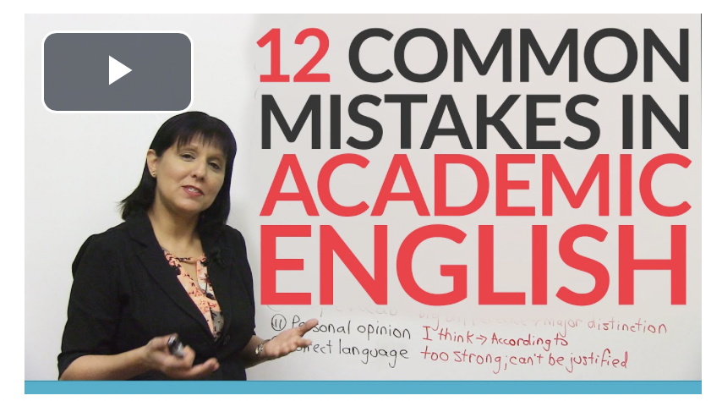
https://www.youtube.com/watch?v=mZQgd2sPxpk

Slide 22
Let’s do a quiz!

